Slide 1
Introduction to Logic Gates
Presented by Richard Herbert

Slide 2
What are Logic Gates?
Description …
Basic building blocks of a digital circuit
Data processing on the circuit is controlled using transistors
Output depends on the logic gate and the input
Input is one of two states – high or low
Output is one of two states – high or low
There are seven types of logic gates

Slide 3
What are Logic Gates?
There are three basic types of logic gate.
AND gate
OR gate
NOT gate

Slide 4
The AND Gate

Slide 5
The AND Gate

Slide 6
The OR Gate

Slide 7
The OR Gate

Slide 8
The NOT Gate
The logical inverter

Slide 9
The NOT Gate

Slide 10
Thinking in Binary
+
-
HIGH
LOW
YES
NO
TRUE
FALSE
1
0

Slide 11
True or False?
The AND Gate
TRUTH TABLE
A
B
Q
0
0
0
A
Q
0
1
0
B
1
0
0
1
1
1

Slide 12
True or False?
The OR Gate
TRUTH TABLE
A
B
Q
0
0
0
A
Q
0
1
1
B
1
0
1
1
1
1

Slide 13
True or False?
The NOT Gate
TRUTH TABLE
A
Q
0
1
A
Q
1
0

Slide 14
Combining Logic Gates
An AND gate and a NOT gate
A
C
Q
B

Slide 15
Combining Logic Gates
NAND gate
A
C
Q
B

Slide 16
Combining Logic Gates
An AND and
NOT Gate (NAND)
TRUTH TABLE
A
B
C
Q
0
0
0
1
A
C
0
1
0
1
Q
B
1
0
0
1
1
1
1
0
Q = NOT (A AND B)

Slide 17
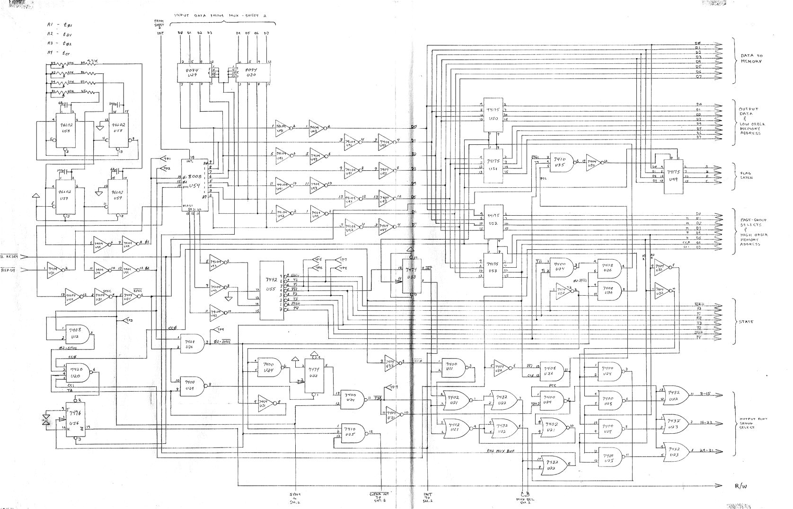
Notes:
Complex logic gates (Mr. Spock’s brain).

Slide 18
Experiment and Play …
http://logic.ly/demo/

Slide 19
Into the Future …
Logic statements
NAND gates
NOR gates
XOR gates
XNOR gates
Notes:
You can go back to the OR gate slide (slide 12), and negate the results, creating a NOR (NOT OR) gate.
Using the same slide you can talk about the results of the XOR (exclusive OR) and XNOR (exclusive NOT OR) gates.

